Slide 1
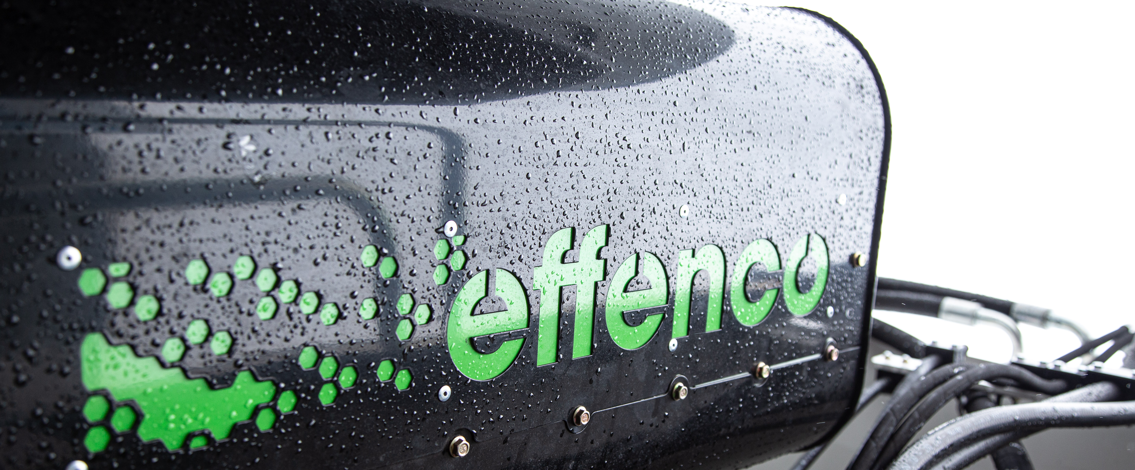


Connectivity and Data at the service of e-mobility manufacturers
effenco.com

Slide 2
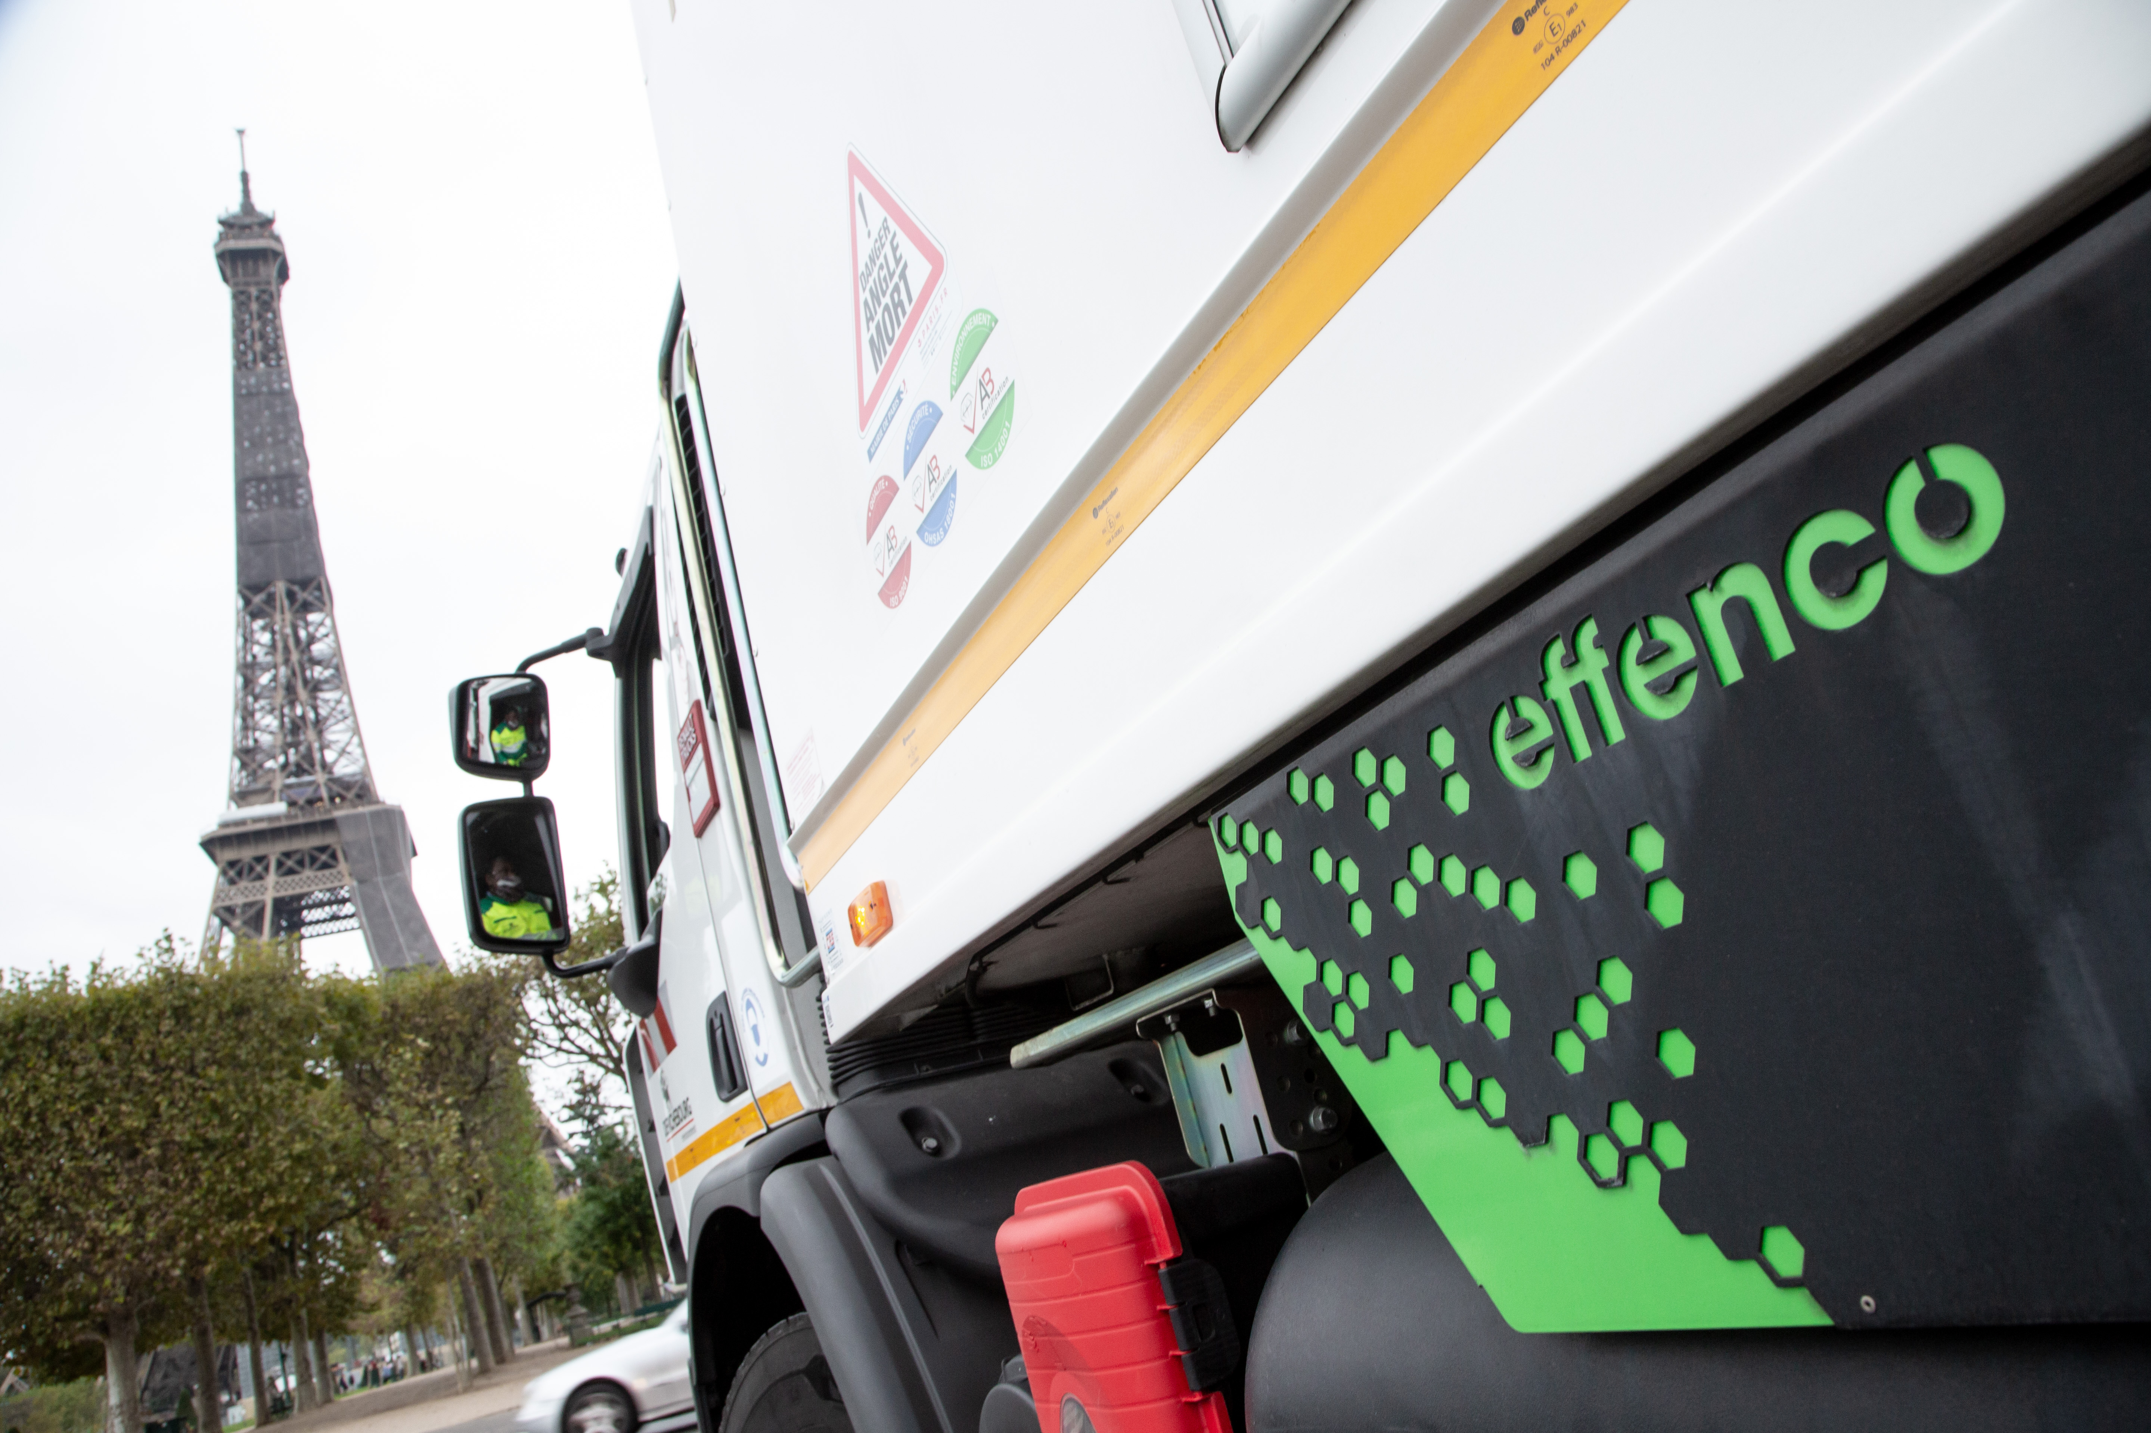
Effenco’s
Electrification Process
Electrification solutions adapted
to customers needs and objectives
Effenco designs, manufactures and markets technologies for the electrification
of heavy-duty vocational vehicles.
Our 2-phase process reduces your GHG emissions with the fastest return on investment and a seamless integration into your operations.
Effenco Development Inc. / Confidential
Notes:
Effenco is THE partner of choice for the electrification of heavy-duty vocational trucks
We offer solutions that provide a true process towards the complete electrification of your fleets
Our electric and connected technologies adapted to the industry allow you to :
Reduce your GHG emissions by up to 100%.
Offer the best return on investment in the industry
Integrate seamlessly with your operations

Slide 3



Easy to operate
Electrification – Phase 1
Electric Hybrid System
Enables the activation
of auxiliary equipment
while eliminating the
use of the engine when
the vehicle is stationary.
Truck stops,
system
shuts down
the engine.
Truck is idling,
system
electrifies auxiliary equipment
(including HVAC).
Brake release,
system automatically restarts
the engine.
Optimal energy efficiency during idling time.
NO
infrastructure required
changes to customer’s operations
Effenco Development Inc. / Confidential
Notes:
Our technology is perfectly adapted to your operations.
Does not require any infrastructure.
Does not change the way your vehicles are driven. No impact on your drivers.
The technology :
Allows to store energy
Stops the engine
Powers the auxiliary equipment (EPTO) and assists the propulsion during the restart

Slide 4
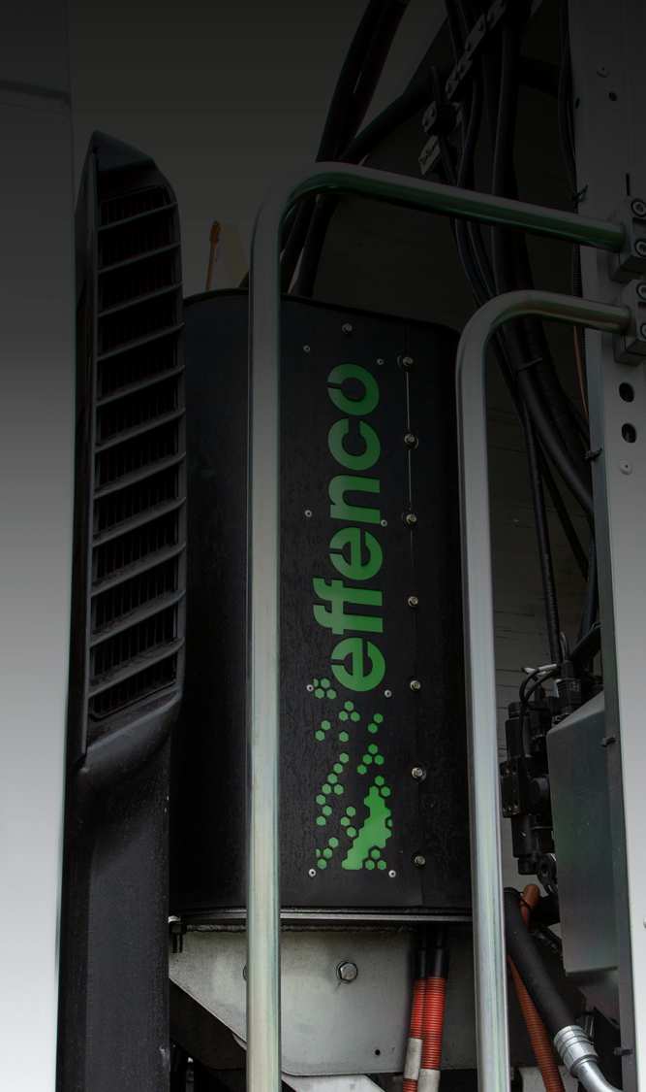







Electrification Solutions
for Heavy-duty
Vocationnal Trucks
Technologies adapted to new and existing trucks, offering the greatest benefits to vehicles that make frequent stops.
DUMP
BUCKET
COLLECTION
i
TRACTORS
CONCRETE
DELIVERY
Effenco Development Inc. / Confidential
Notes:
Technology specially designed for trucks that make frequent stops
Adaptable to new and existing trucks
Adaptable to several types of vehicles
[If needed, show relevant videos depending on the customer you are meeting with]

Slide 5

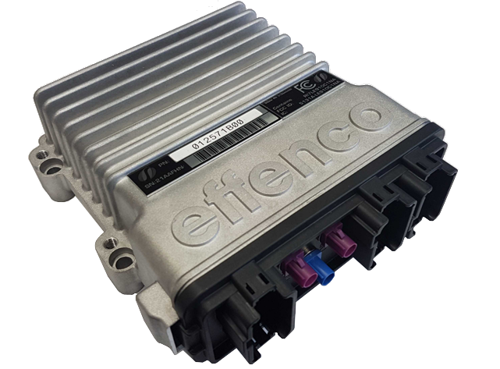
Effenco
Connectivity
And
Data acquisition
Engineering
Development
Validation
Verification
After-sales Service
Problem analysis
Performance reporting
Over 1 M hours of Data and still counting.
Innovation
New product ideas
Improvements
Sales
​
Real use case analysis​
Performance predictions
Développement Effenco Inc. / Confidentiel

Slide 6
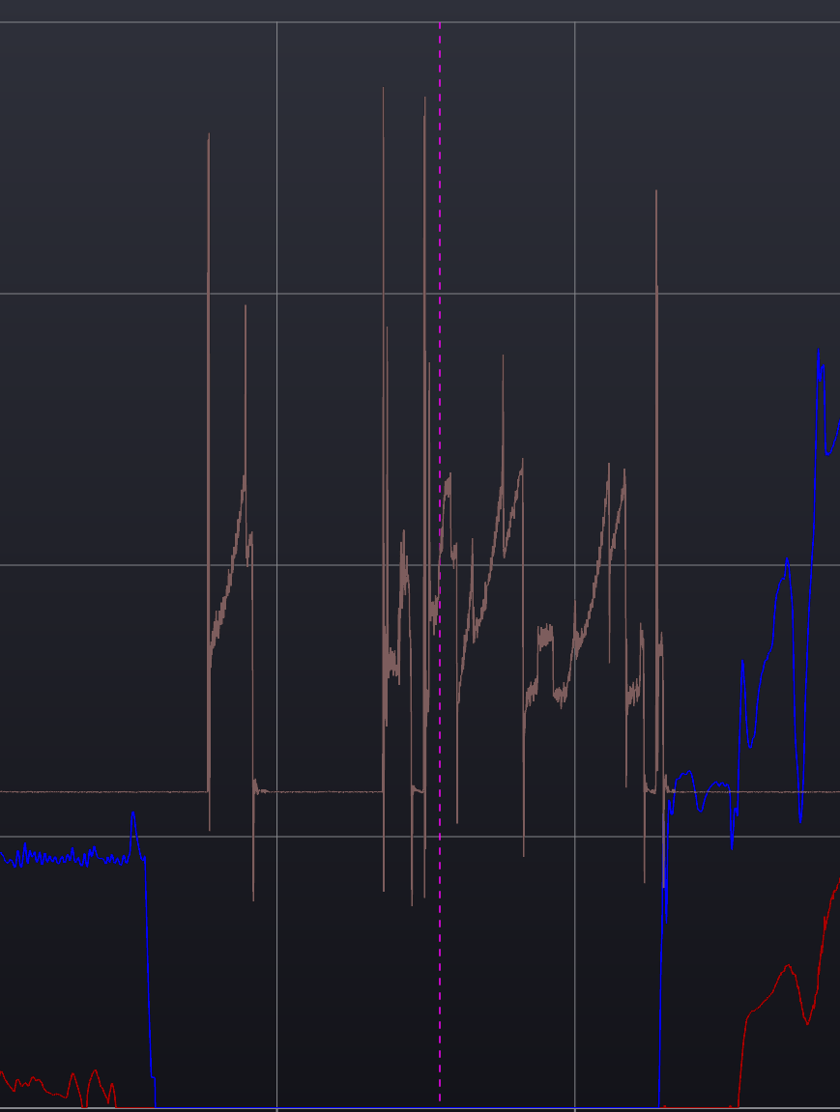
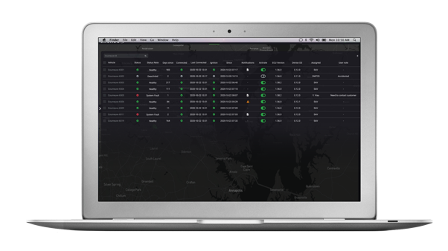
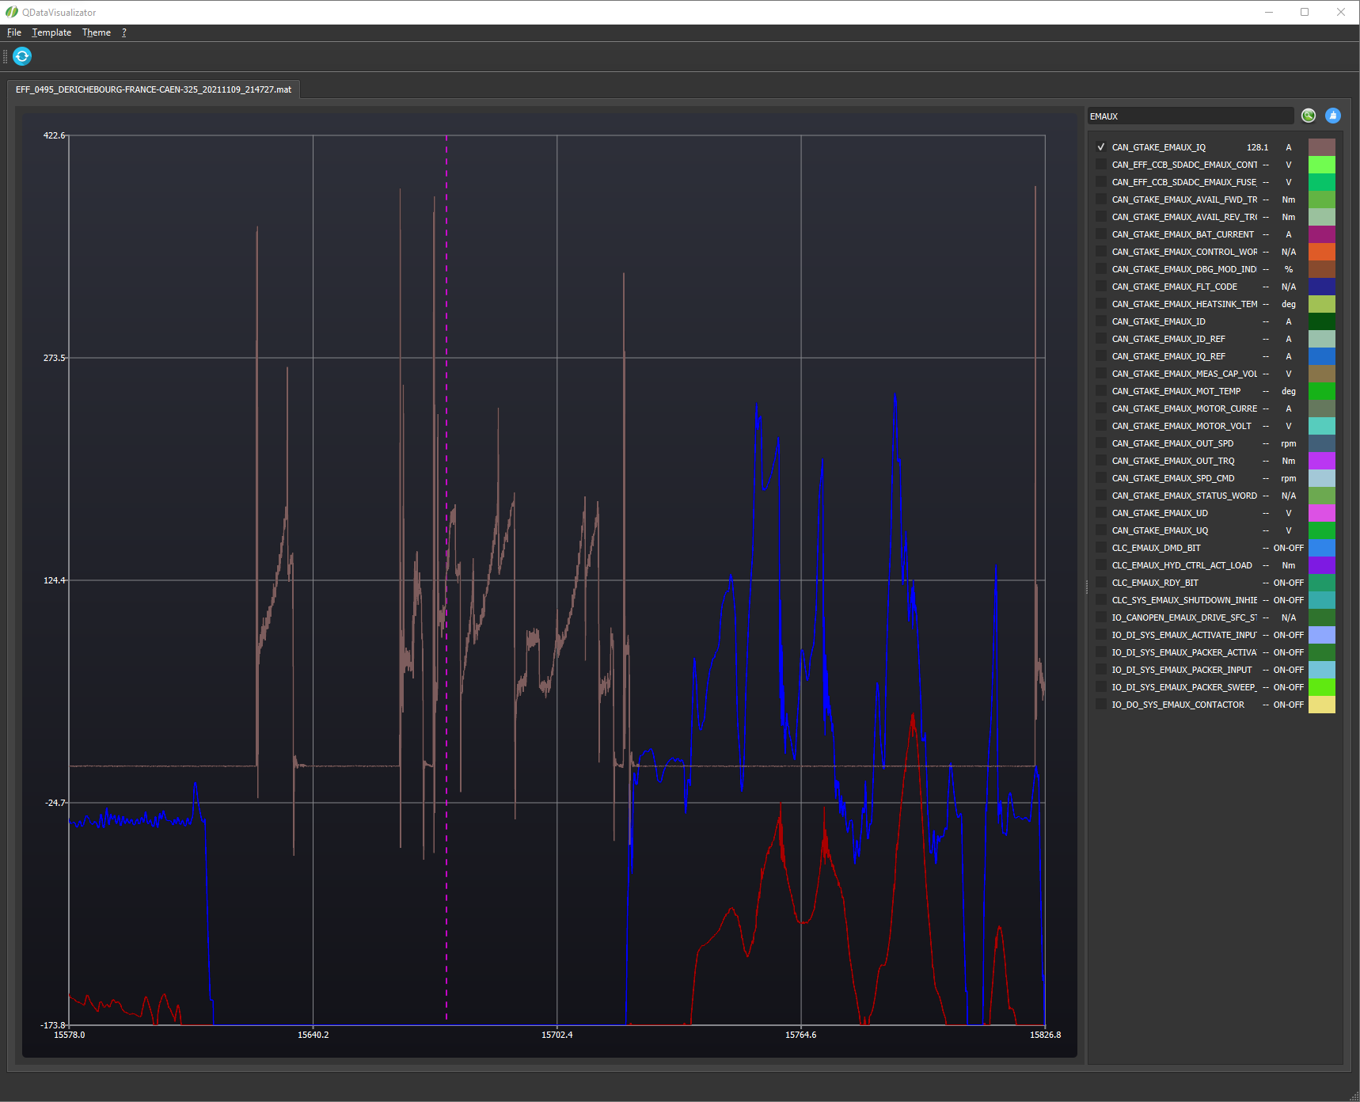
Electrification Solutions
for Heavy-duty
Vocationnal Trucks
Time series analysis, is available for engineering study as well as diagnostic by the after sales team.
Facilitates remote updates.
helps our team to identify issues in a timely manner.
Machine learning, projects are in the work to automatically detect abnormal conditions of the hybrid system and classify them.
Identify problems that might never be discovered otherwise.
Allow the team to focus on the problem. Instead of trying to find the occurrences in multiple datafiles.
Help improve performance of the product.
Effenco Development Inc. / Confidential
Notes:
Service technicians have access to time Series to allow fast and precise diagnostics.

Slide 7
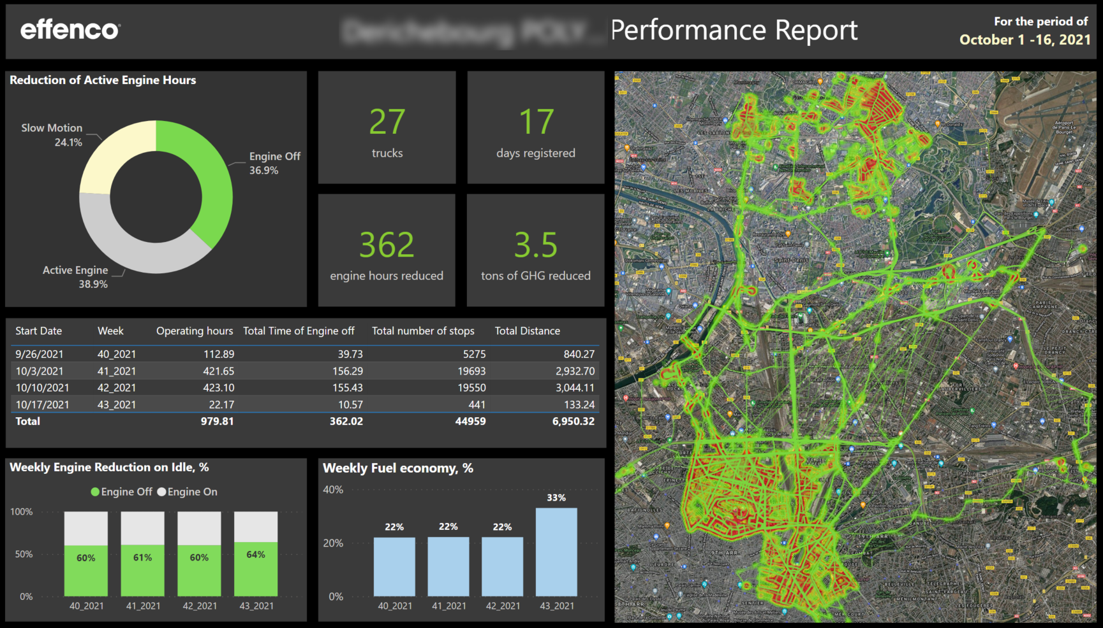
Effenco
Automated performance reports for customers
Enforce credibility with customers
Ensure more orders from existing customers
Performance predictions
Predict potential saving for a non-equipped fleet.
Effenco Development Inc. / Confidential

Slide 8
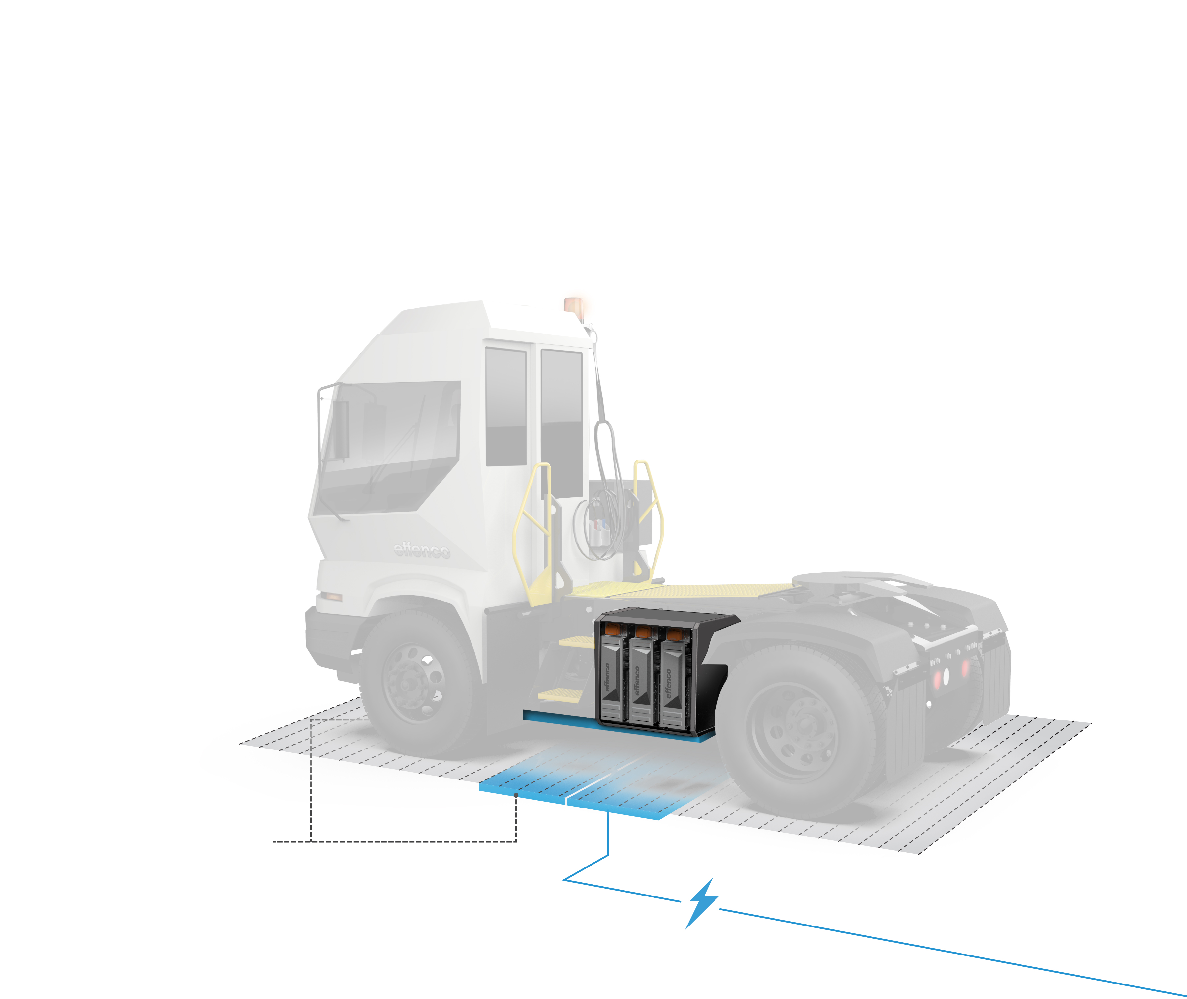
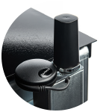
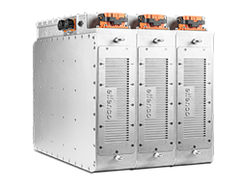

Electrification – Phase 2
100% Electric Powertrain
Full electric powertrain for the
same upfront cost as diesel-equivalent alternative.
Our data and algorithms ensure
that energy efficiency is optimized throughout the route.
Fast charging by induction.
No operator intervention required.
Allows the truck to follow
its usual route.
Unlimited range
(24h operation).
A.I. based algorithms allow electrification with 20x less energy
on board.
Same proven
Ultracapacitor
Technology.
Wireless induction charging
along truck route.
Effenco Development Inc. / Confidential
Notes:
Electric Powertrain
Combination of Ultracapacitor (propriatary technology) + AI + induction charging
Enables less energy on board -> lowering upfront cost
Also, with wireless charging, no intervention required. Charging while you work!
Can be installed on all chassis types
Introduce also the notion that when hybrid system is already installed, enables us to already gather data to help optimize the full EV system.

Slide 9
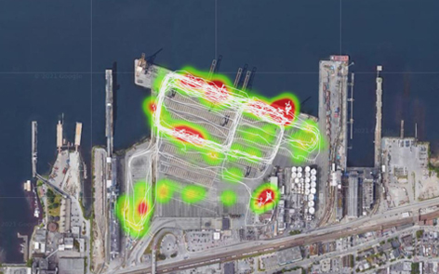

Port Case Study
100% Electric Powertrain with
Scalable and Adaptable Infrastructure
30%
Investment in infrastructure delayed
30% fuel savings at the outset.
Optional range extender provides the rest of the energy required.
Wireless recharging deployment adapted to your objectives.
50%
Charging infrastructure investment can be delayed.
Our all-electric powertrain achieves 30% GHG reduction at the outset.
Rest of implementation can be progressive until 100% electrification.
Progressive investment in infrastructure
Effenco's algorithms used to strategically position the charging stations according to your GHG reduction objectives.
Optional range extender provides the rest of the energy required.
100%
Optimised investment in infrastructure
Full electrification achieved.
Effenco Development Inc. / Confidential
Notes:
Our electric powertrain solution also allows for a gradual deployment of charging infrastructure.
From the start, even if no infrastructure is in place, the system remains functional. It then allows for a 30% fuel savings.
Fuel savings will gradually increase as wireless charging stations are added until full electrification is achieved.
Our A.I. algorithms are used to strategically position the infrastructure.

Slide 10





















100% Electric Powertrain with
Scalable and Adaptable Infrastructure
  Model refinement
  Include but not limited to
  Simulation model
  Fleet parameters
  Vehicle data
  Position
  Speed
  Fuel rate
  Driver inputs
  State of charge
  Hybridisation level
  Optimization
  Algorithm
  Heat Map
  Optimized charging point location
  Optimized Electric powertrain size
  Performances predictions
  Performances results
  Result report
  Fleet implementation
Effenco Development Inc. / Confidential
Notes:
Our electric powertrain solution also allows for a gradual deployment of charging infrastructure.
From the start, even if no infrastructure is in place, the system remains functional. It then allows for a 30% fuel savings.
Fuel savings will gradually increase as wireless charging stations are added until full electrification is achieved.
Our A.I. algorithms are used to strategically position the infrastructure.
Path planning

Slide 11
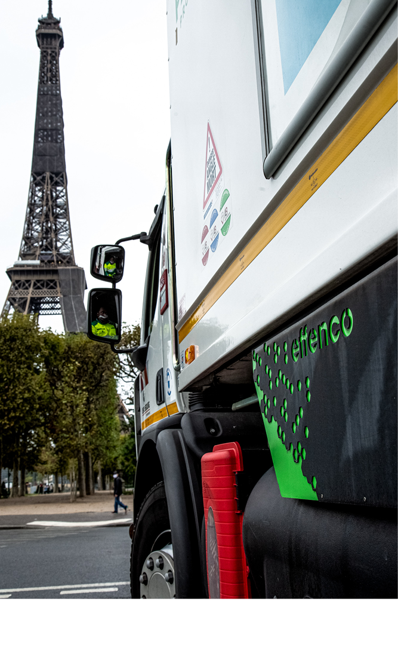
Thank You
effenco.com | info@effenco.com | T : +1 514 397 4020
“This document and its contents are proprietary and constitute confidential information of Effenco Development Inc. Neither this document, nor any part of it, may be disclosed or conveyed to, or used or copied by or for, any third party, without the prior written consent of Effenco Development Inc. © 2021 Effenco Development Inc. All rights reserved.”

Slide 12
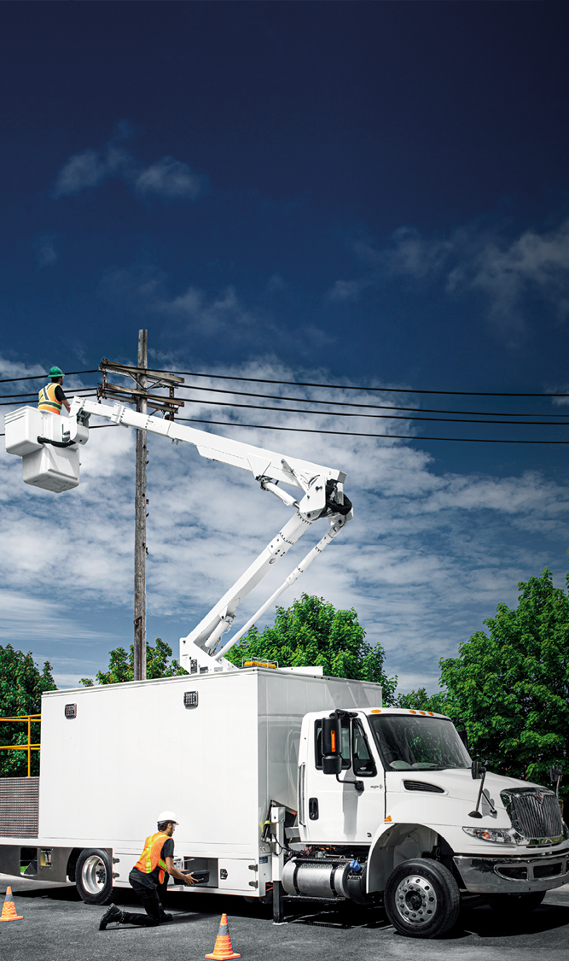
HEALTH AND SAFETY ENVIRONMENT
SAVINGS
Effenco Technology
Electric Hybrid System
Lower
Maintenance Cost
No
Infrastructure
Required
40 ^{to} 50%
Engine Hours*
Reduction
PM and NOx
Immediate
Benefits
20 ^{to} 35%
Fuel Consumption*
20 ^{to} 35%
Reduction of GHG Emissions*
Quieter
Operations
*Results may vary depending on idling time
Effenco Development Inc. / Confidential
Notes:
[Note: this page contains a lot of information. In order not to "lose" people, it is recommended to make the presentation from the outside of the circle, i.e. to talk about the broad levels on which Effenco technology has benefits, and then focus on 2-3 essential elements for the client].
For example:
The benefits of Effenco technology can be found on several levels:
The savings it allows to achieve
The positive impact on the environment
And its impact on the health and safety of people
More specifically, I would like to draw your attention to the fact that the Effenco system:
Allows reductions of 20 to 35% on fuel consumption. This has a direct impact on the reduction of GHG
By turning off the engine when the vehicle is stationary it also reduces engine hours by 40-50% which greatly contributes to reducing your maintenance costs
Turning off the engine also reduces noise for not only safe operations but also for a quieter environment for the surrounding population

Slide 13








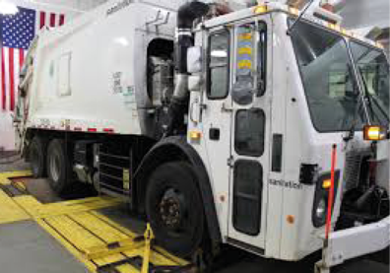
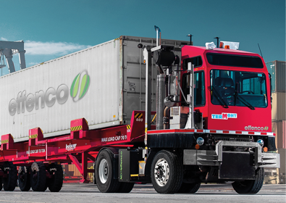
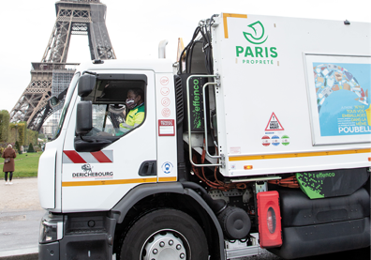
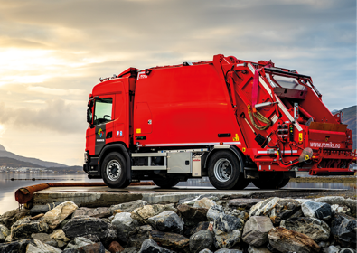
Hybrid Electric System
Field Proven
by Customers
New York
Montréal
Paris
Oslo
Développement Effenco Inc. / Confidentiel
Notes:
We already have several renowned partners around the world.
Several of our customers are also at the stage of complete transition of their fleet. This is the case for Termont and Derichebourg, for example.
It is also worth noting that Effenco has been named one of the Top100 Cleantech Companies. This nomination testifies to our desire and commitment to develop green and sustainable solutions.
We have also received the "Solar Impulse Efficient Solution" label which underlines the benefits of our technology.

Slide 14
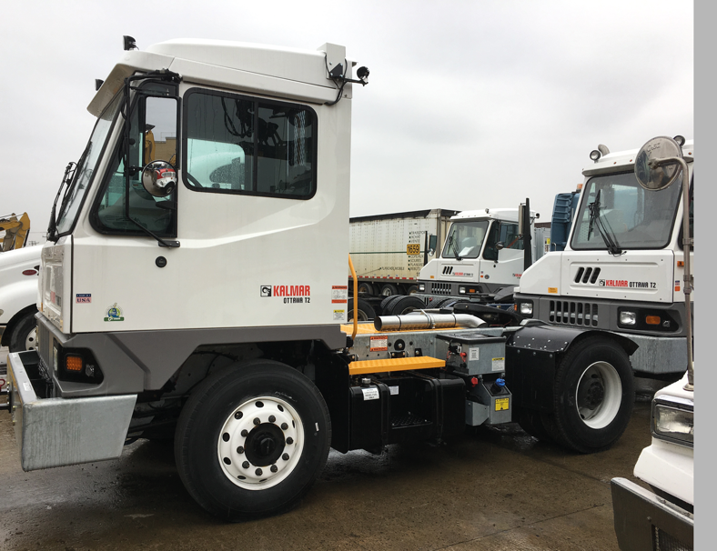
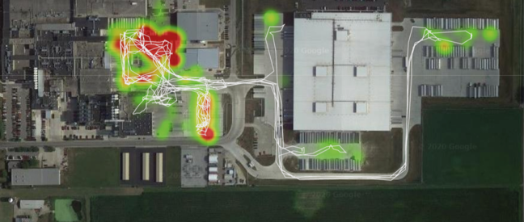
Client Case
Electric Hybrid System
Distribution Center
Context
In distribution centers, vehicles travel
short distances at very low speeds,
putting additional pressure on
after-treatment systems and
consequently on maintenance costs.
Reduction*
Engine Time 57%
Fuel/GHG 37%
Total 1 vehicle / 286 hours
NOx 55%
PM 67%
Objective
The customer wanted to reduce the engine hours of its fleet to lower its maintenance costs.
Results
The Effenco System enabled a 57% reduction in engine time.
Real-time monitoring of idling times demonstrates opportunities for pollution reduction.
Fine particle density :
High Low
*Statistics based on data obtained for 286 operating hours for the period June 10 to July 10, 2019. Results for NOx and PM were inferred from laboratory tests.
Effenco Development Inc. / Confidential
Notes:
Let me present you with 3 client cases where Effenco technology has made a difference.
Draw attention to the following points:
The Heatmap allows you to clearly see the impact areas of the technology
Maintenance costs directly related to engine hours
Effenco technology has reduced engine hours by 57%.

Slide 15
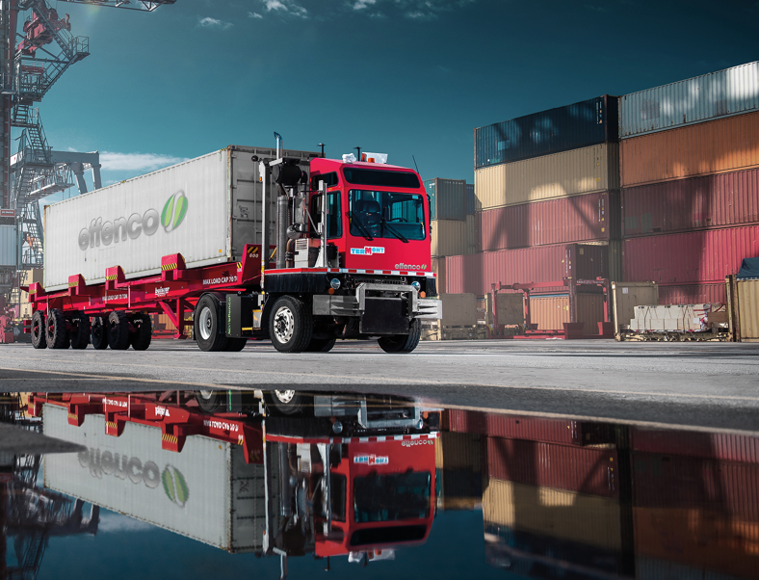
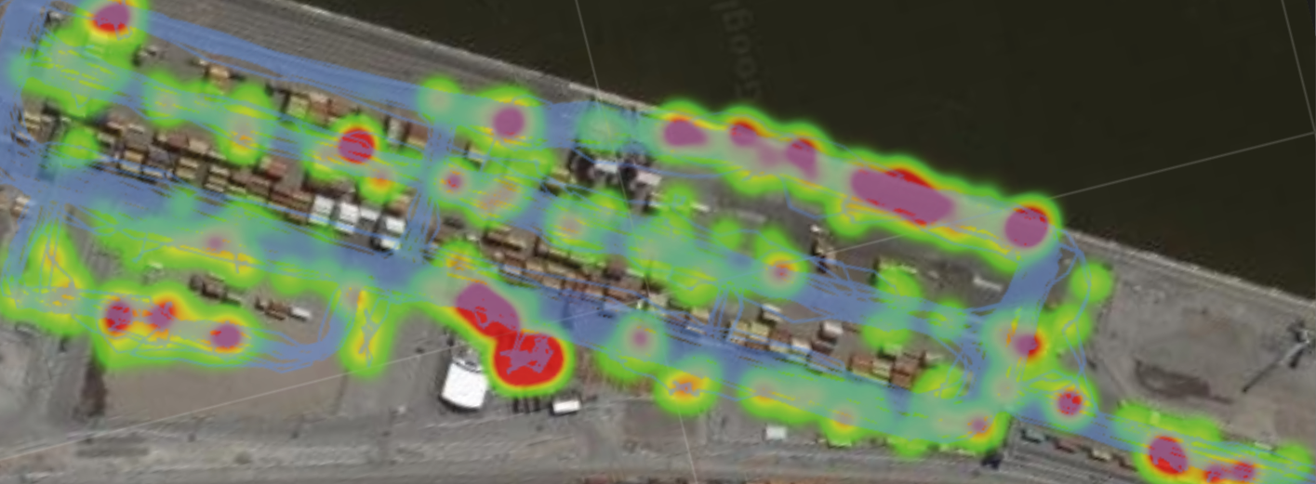
Client Case
Electric Hybrid System
Port Operations
Context
This client's activities were located in an urban area. He therefore sought to reduce the pollution associated with his activities yielding better air quality for neighboring populations.
Reduction*
Engine Time 54%
Fuel/GHG 30%
Total 5 vehicles / 4,694 hours
NOx 45%
PM 54%
Real-time monitoring of idling times demonstrates
opportunities for pollution reduction.
Fine particle density :
High Low
Objective
Reduce the emission of NOx and fine particles to improve air quality.
Results
The Effenco System enabled a 45% reduction in NOx and 54% reduction in fine particles.
*Statistics based on data for five (5) demonstrator vehicles for 4,694 operating hours for the period December 1st 2019 to April 28th 2020. Results for NOx and PM were inferred from laboratory tests.
Effenco Development Inc. / Confidential
Notes:
The use of technology in the Ports = another good example
Draw attention to the following points:
The Heatmap allows you to clearly see the areas of impact of the technology
Significant reductions on all indicators

Slide 16

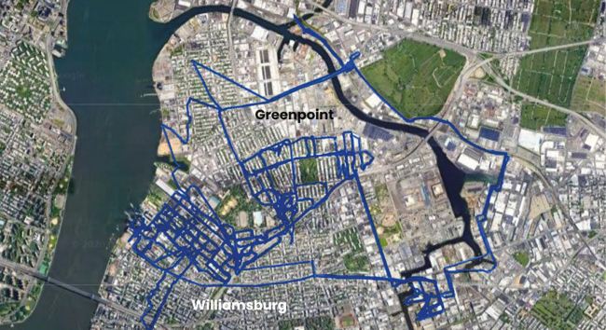
Client Case
Electric Hybrid System
Collection Trucks
Context
Client in very high-density urban area facing various pollution and noise issues.
Reduction*
Brooklyn North 64%
Manhattan 60%
Engine
Time
All boroughs 59%
Total 151 vehicles
Brooklyn North 38%
Manhattan 34%
Fuel
GHG
All boroughs 32%
Objective
The client wants to reduce their GHG emissions by 40% by 2030. The waste collection system has been identified as an opportunity to achieve this goal.
Results
The Effenco System has enabled a 32% reduction in GHG emissions in addition to offering a significant reduction in noise during operations, thanks to a 59% reduction in engine hours.
Opportunities for pollution reduction throughout the entire neighbourhood
*Statistics on potential based on data from 151 vehicles over 421,639 operating hours for the period December 5, 2012 to November 1, 2013.
Effenco Development Inc. / Confidential
Notes:
Draw attention to the following points:
Regardless of the environment (inner city with Manhattan or suburban), Effenco technology has resulted in significant reductions in both engine hours and fuel consumption
In a very urban context, noise reduction is also an important element to consider.

Slide 17
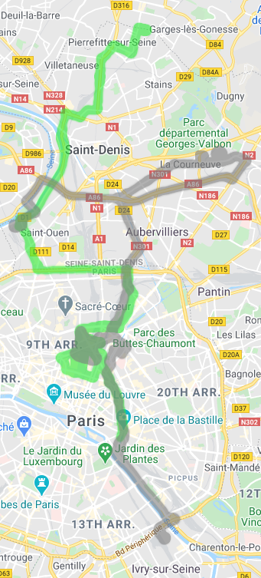
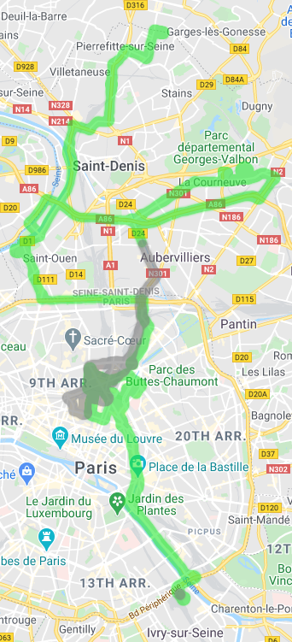
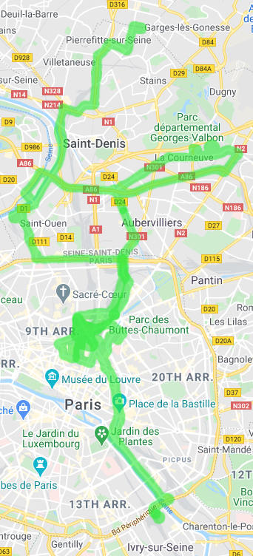
City Case Study - Paris
100% Electric Powertrain with
Scalable and Adaptable Infrastructure
Wireless recharging deployment adapted to your objectives.
Charging infrastructure investment can be delayed.
Our all-electric powertrain achieves 30% GHG reduction at the outset.
Rest of implementation can be progressive until 100% electrification.
30%
Investment in infrastructure delayed
30% fuel savings at the outset.
Optional range extender provides the rest of the energy required.
50%
Progressive investment in infrastructure
Effenco's algorithms used to strategically position the charging stations according to your GHG reduction objectives.
Optional range extender provides the rest of the energy required.
100%
Optimised investment
in infrastructure
Full electrification achieved.
Effenco Development Inc. / Confidential
Notes:
Our electric powertrain solution also allows for a gradual deployment of charging infrastructure.
From the start, even if no infrastructure is in place, the system remains functional. It then allows for a 30% fuel savings.
Fuel savings will gradually increase as wireless charging stations are added until full electrification is achieved.
Our A.I. algorithms are used to strategically position the infrastructure.

Slide 18

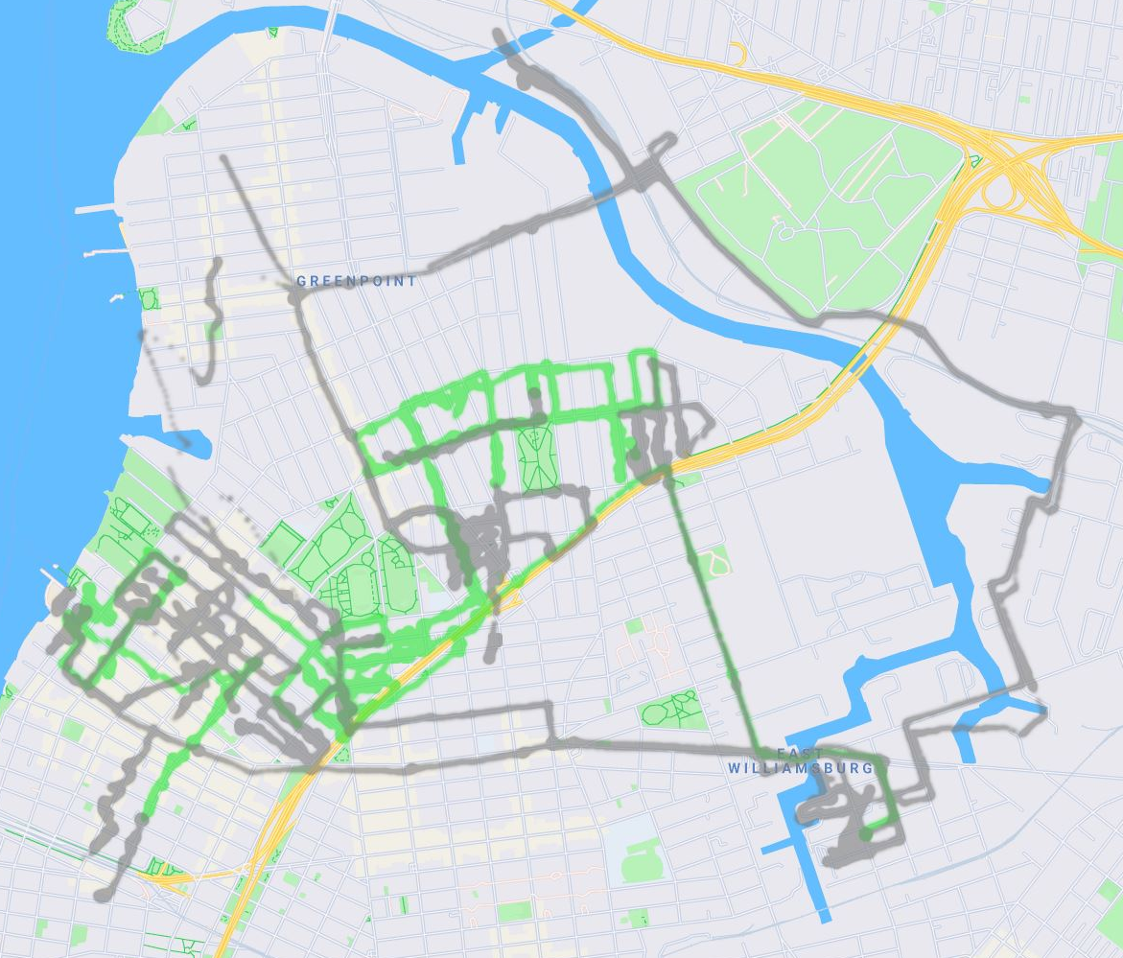

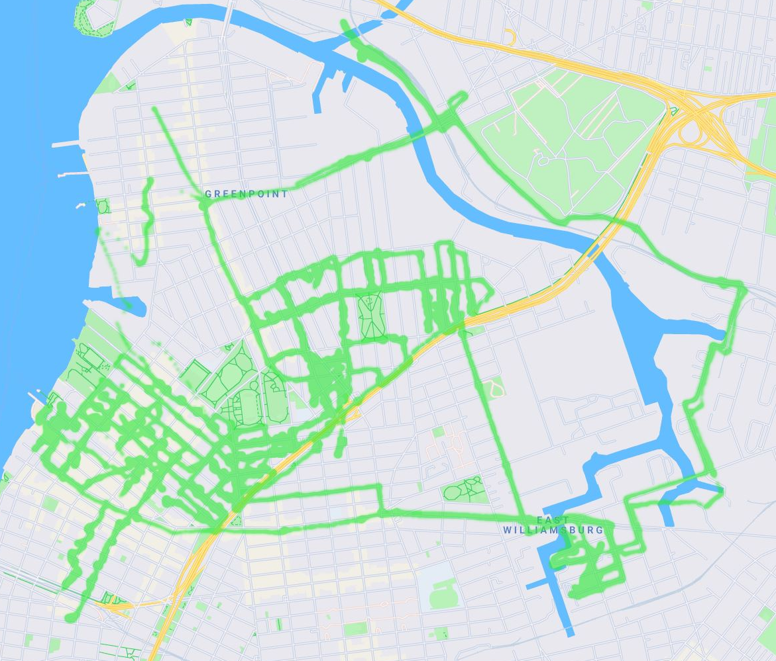
City Case Study - NYC
100% Electric Powertrain with
Scalable and Adaptable Infrastructure
30%
Investment in infrastructure delayed
30% fuel savings at the outset.
Optional range extender provides the rest of the energy required.
Wireless recharging deployment adapted to your objectives.
50%
Charging infrastructure investment can be delayed.
Our all-electric powertrain achieves 30% GHG reduction at the outset.
Rest of implementation can be progressive until 100% electrification.
Progressive investment in infrastructure
Effenco's algorithms used to strategically position the charging stations according to your GHG reduction objectives.
Optional range extender provides the rest of the energy required.
100%
Optimised investment in infrastructure
Full electrification achieved.
Effenco Development Inc. / Confidential
Notes:
Our electric powertrain solution also allows for a gradual deployment of charging infrastructure.
From the start, even if no infrastructure is in place, the system remains functional. It then allows for a 30% fuel savings.
Fuel savings will gradually increase as wireless charging stations are added until full electrification is achieved.
Our A.I. algorithms are used to strategically position the infrastructure.

