Slide 1
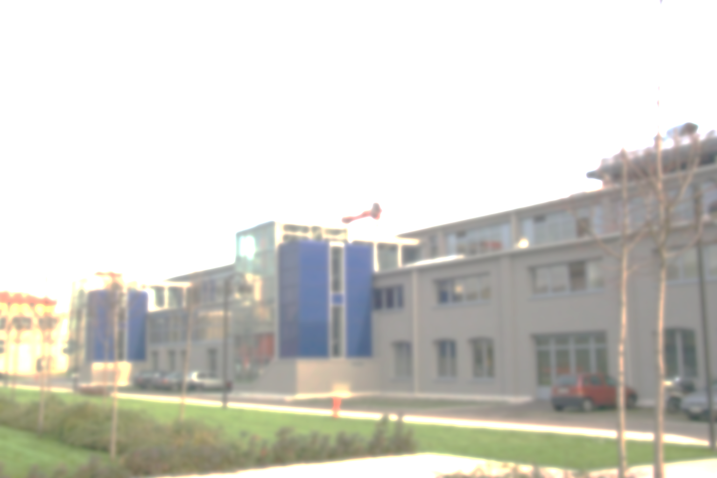
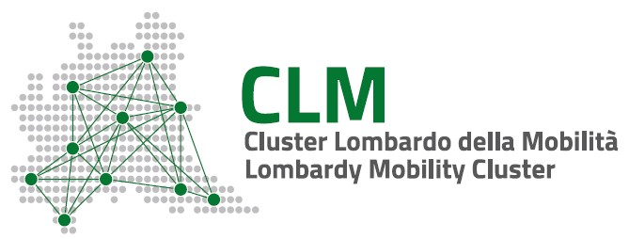

AI @ Lombardy Mobility Cluster
Prof. dr-ing G Mastinu
gianpiero.mastinu@polimi.it
Canada-Italy Business Forum on AI – 18 november 2021
Aula Magna – Rettorato
Mercoledì 27 maggio 2015

Slide 2
Outline
Lombardy Mobility Cluster
AI & product development
AI & process development
AI & infrastructure development
Conclusion

Slide 3



www.clusterlombardomobilita.it
Saverio Gaboardi
President CLM
Giampiero Mastinu
Secretary General CLM

Slide 4
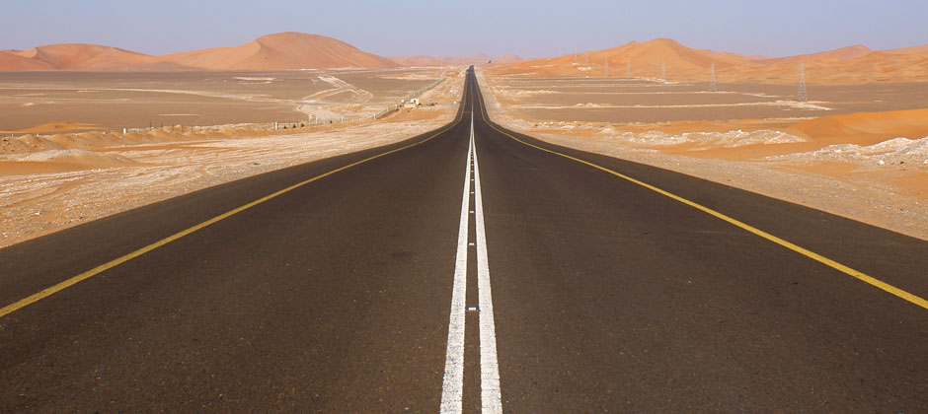


LOMBARDY MOBILITY CLUSTER
Automotive
Waterborne
Railway
Intelligent Transportation Services
ITS

Slide 5
LOMBARDY MOBILITY CLUSTER
74 partners
6 trade associations
20 big entreprises
42 SMEs
6 uniersities/research centers
Yearly turnover of CLM companies >> 10 bln €

Slide 6
Automotive
AUTOMOTIVE INDUSTRY FROM LOMBARDY
>50.000 employees (direct),
>300.000 employees (indirect)
> 20 billions budget
~ 1.000 companies, 90% SME
1st in EU for innovative SMEs
2nd in EU for number of employees
4th automotive cluster in Europe (1st in Italy with Piedmont) (source:eocic)
Notes:
In questa ottica già dal 2009 abbiamo avviato, con il sostegno della Regione Lombardia, l’attività della filiera lombarda, basata sui centri di Brescia, Bergamo, Milano, Lecco.
Come detto parliamo di oltre 50.000 addetti in oltre 1.000 aziende (90% sono PMI), con un fatturato di oltre 20 miliardi di euro.

Slide 7
Waterborne
Italy
1° in the world: 21.7% of market share
Lombardy: 1° in Itay number of companies (25% of total italian)
+ many TIER 2 & 3
Source: Osservatorio CLM 2015

Slide 8
Rail vehicles
Lombardy: biggest number of companies in Italy (source: ASSIFER)
Turnover: 1,3 bln € (2013)
Source: Osservatorio CLM 2015

Slide 9
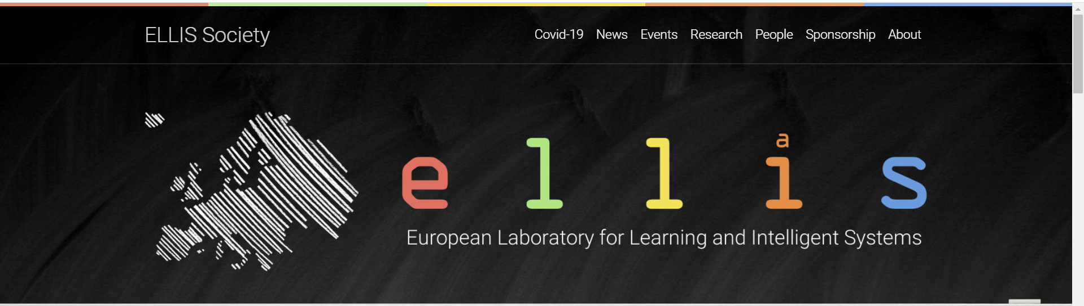
ELLIS: European network for AI
https://ellis.eu/units

Slide 10
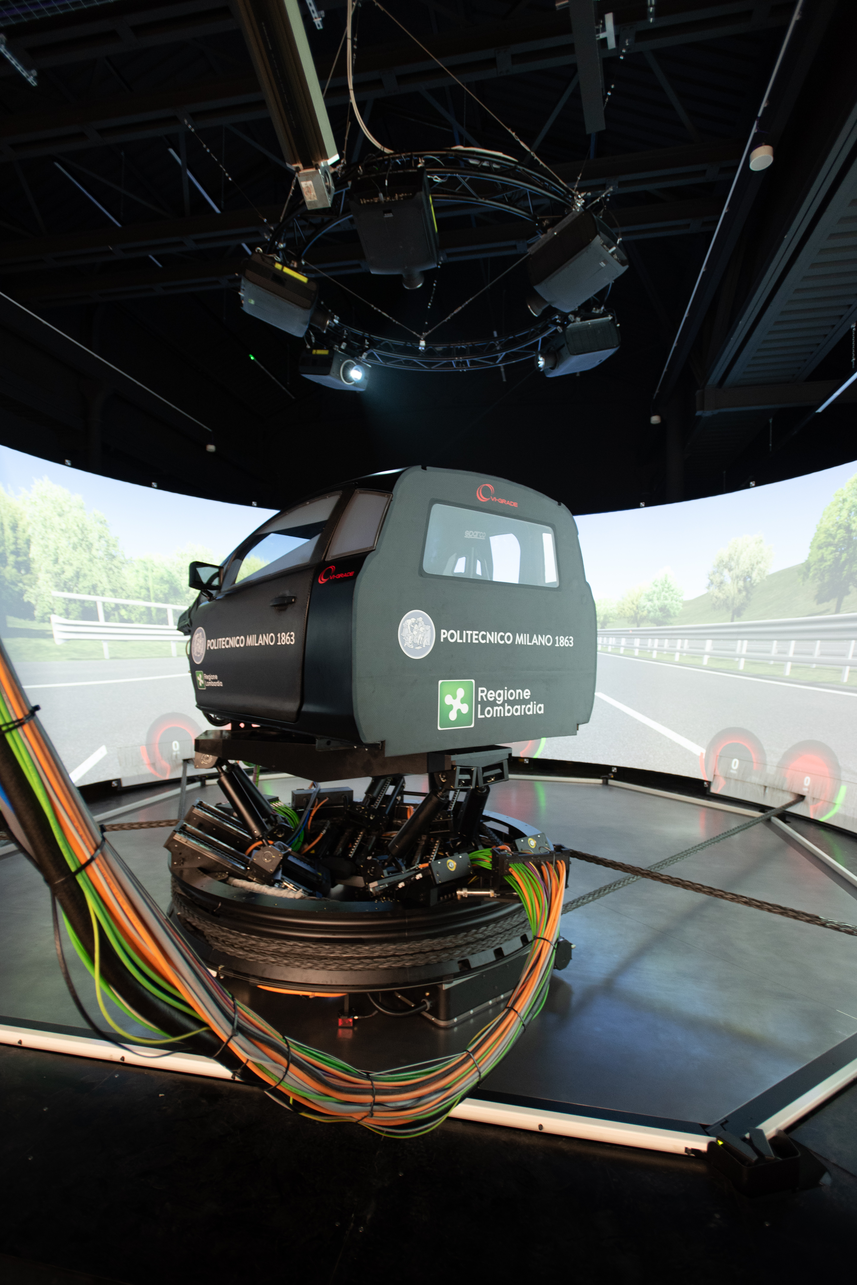


AI & PRODUCT DEVELOPMENT
DESIGN OF SUSPENSION & TYRES

Slide 11
AI & PRODUCT DEVELOPMENT
x
f(x)
digital twin of the car
x
f(x)

Slide 12
AI & PRODUCT DEVELOPMENT
optimization of 72 parameters
considering 38 performance indices

Slide 13
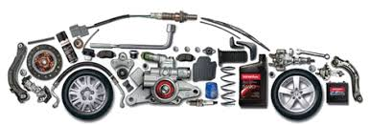
AI & PROCESS DEVELOPMENT
DIGITALIZATION & AI
SINERGY
PRODUCT
PROCESS
Mastinu, G., Cadini, F., and Gobbi, M., "Industry 4.0 and Automotive 4.0: Challenges and Opportunities for Designing New Vehicle Components for Automated and/or Electric Vehicles," SAE Technical Paper 2019-01-0504, 2019, https://doi.org/10.4271/2019-01-0504.

Slide 14
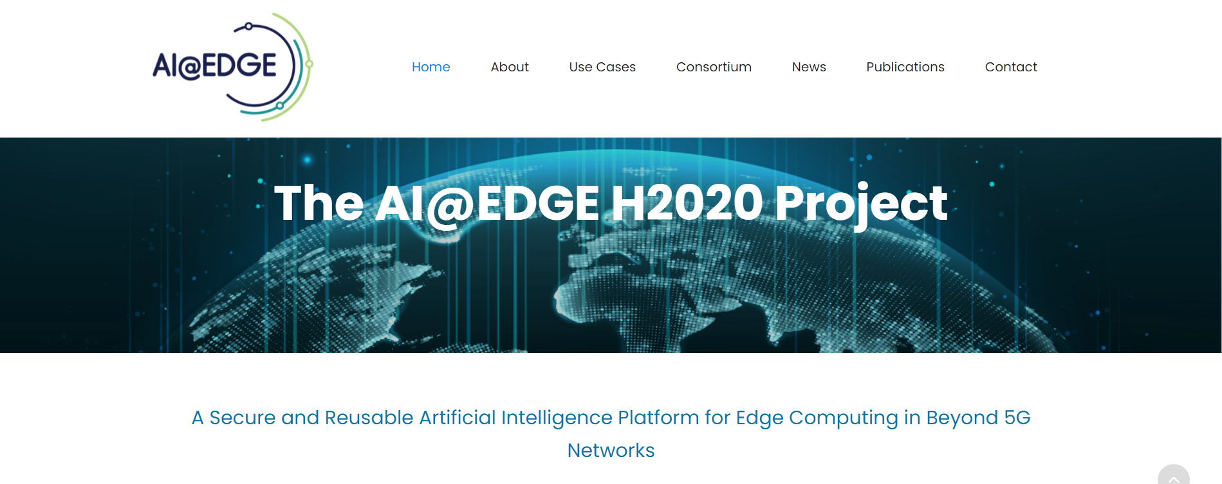
AI & INFRASTRUCTURE DEVELOPMENT
www.aiatedge.eu

Slide 15
AI & INFRASTRUCTURE DEVELOPMENT
5G
Electronic
Traffic
Policeman

Slide 16
Conclusion
Important AI applications:
---digital twin of the vehicle,
---digital twin of infrastructure,
---combination of both
Simulation and digital twins to be a predictive and operational tools
AI: a technology in its infancy, helpful for sustainable mobility

Slide 17
Thank you
Aula Magna – Rettorato
Mercoledì 27 maggio 2015

